Slide 1

Sales Analysis of a Home Based Artificial Jewellery Business To Increase Profitability
VIKAS JAISWAL [21f1006140] [JAN 2024 TERM]
BUSINESS DATA MANAGEMENT PROJECT PRESENTATION

Slide 2
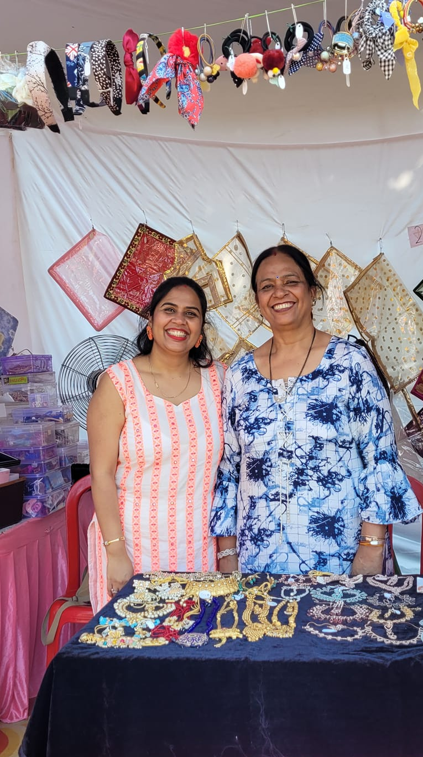
JEWELLERY
‘Fashion Jewellery by Shilpi Jaiswal’ is a home based artificial jewellery business in Gorakhpur Uttar Pradesh.
They specialize in artificial jewellery and have also started stocking other women fashion products.The main problem they are facing is of sales and profitability.

Slide 3
THE PDM:
PROBLEM(S)
DATA OVERVIEW &
METHODOLOGY
TAKEAWAY:
Suggestions to increase profitability and sales
P: LOW SALES & PROFITABILITY
Look into purchase and sales data to make suggestions and offer suggestions
D: DATA COLLECTED [SEP 2023]
Monthly Sales Data(YTD) & Quarterly Purchase Data(One Year)
M: ANALYSIS AND METHOD
Purchase and Sales Data Collected in Excel & Descriptive Statistics.

Slide 4
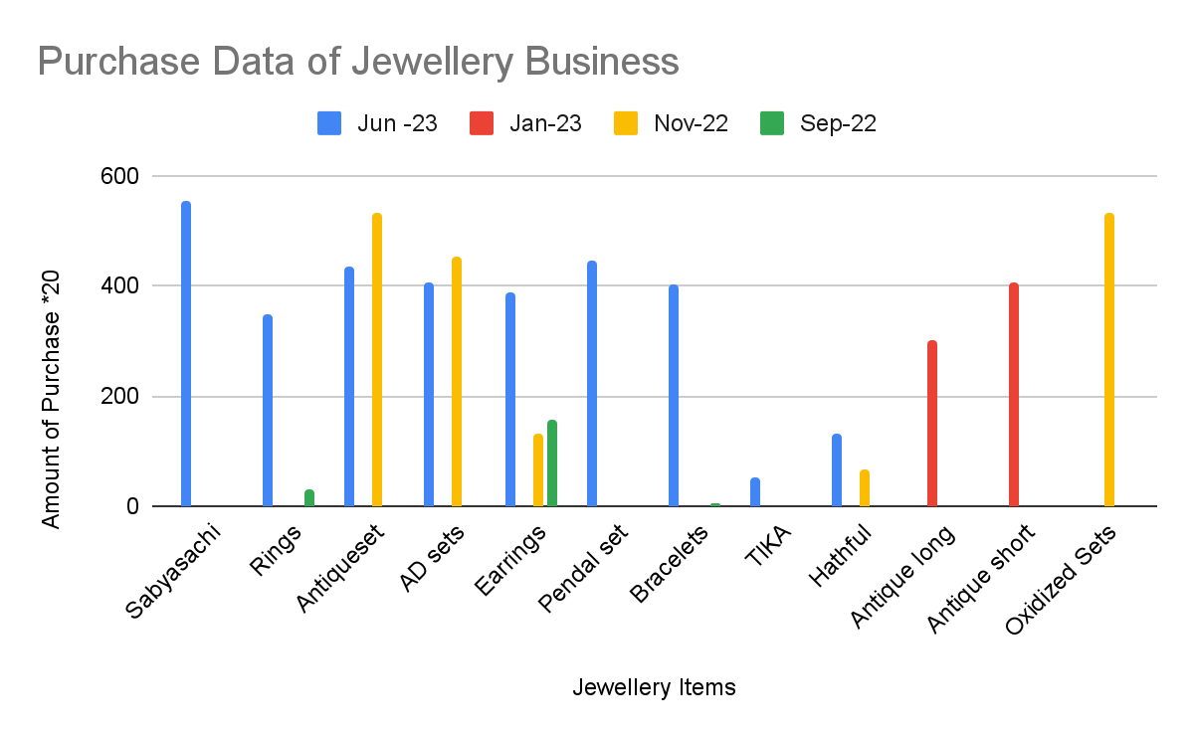
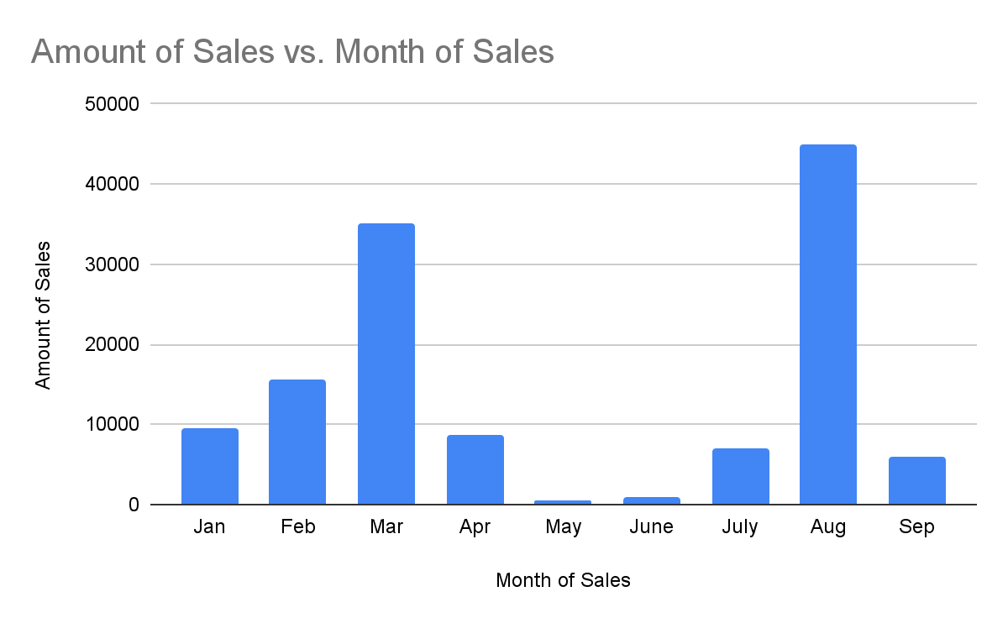
Descriptive Statistics
Descriptive statistics is conducted on purchase and sales data

Slide 5
Descriptive Statistics
Max Sales Month : August 2023
Max Sales Amount : Rs. 45000
Max Purchase Month : June 2023
Max Purchase Amount : Rs. 63360
Product with highest purchase : Antique Set
Average Sale per month : Rs 14247.78
Min of Sales : Rs.500
Median of Sales : Rs. 8700
Standard Deviation of Sales : Rs. 15487.59
Min Purchased product : TIKA
Min purchase : Rs. 3910
Mean of Purchases : Rs. 26292.5
Median of Purchases : Rs. 18950
Standard Deviation of Purchases : Rs. 26004.41

Slide 6
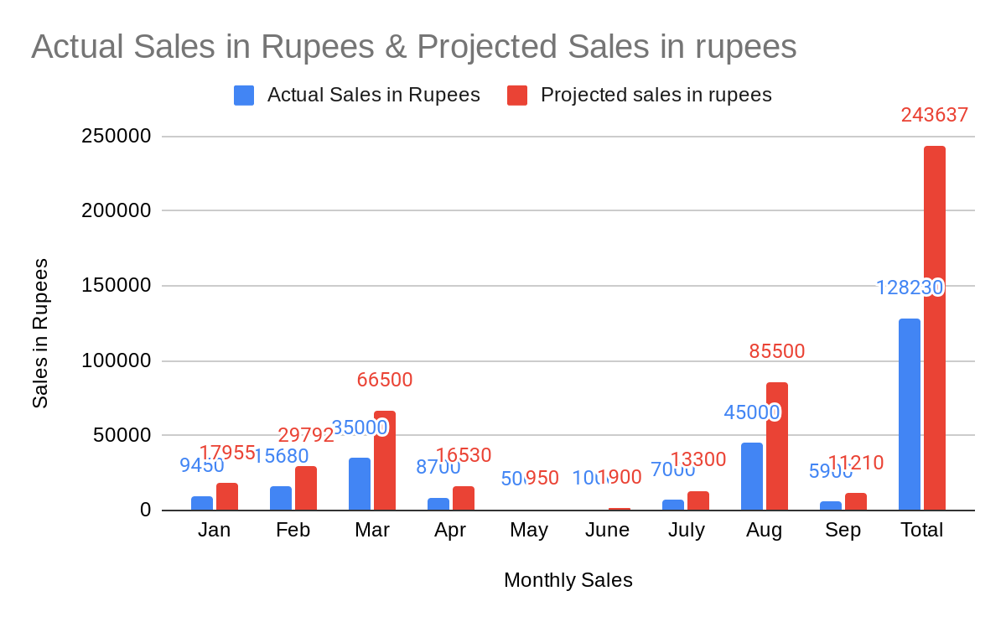
RECOMMENDATIONS SIMULATED MODELLING
Result: Projected Purchase increase by 90% in each quarter can account for 90% increase in revenue
Key assumptions:
It is assumed that the owner keeps the same profit margin and can aim to make higher profits with more revenue.
It is assumed that the owner is well aware of her competitors' costing and has priced her products accordingly.
The sales will have been increased by increasing her sales channel from home to include exhibitions and online store front

Slide 7
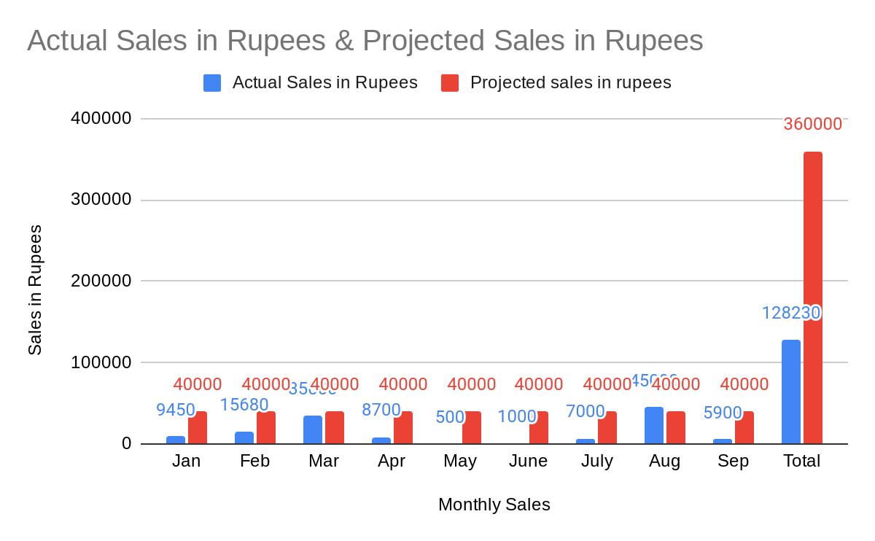
RECOMMENDATIONS SIMULATED MODELLING
Result: If the owner can target for doing one exhibition per month her revenue can increase by 280% for 9 months
Key assumptions:
The owner is putting at least one exhibition per month.
The owner has increased her purchase accordingly to meet the new demand.
For purchases,owner can target wholesale markets in the metros to get deep discount on bulk purchase.

Slide 8
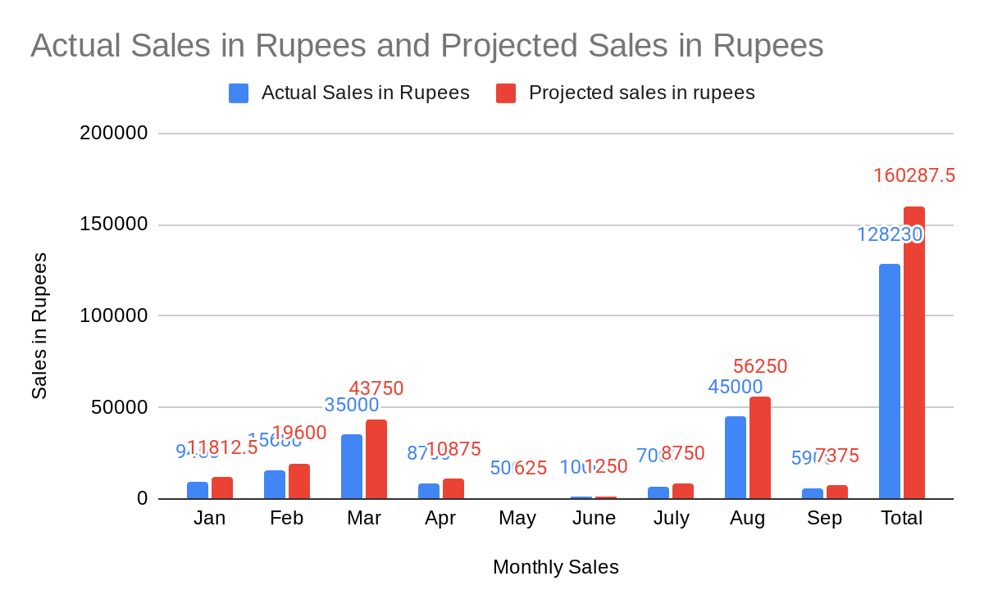
RECOMMENDATIONS SIMULATED MODELLING
Result: The owner is stocking 25% of other women's fashion products like hair bands, makeup kits etc. This will add 25% to existing revenue thus increasing sales and profits
Key assumptions:
Owner key business is artificial jewellery and she continues to specialize in the same.
Other fashion women products are complementary to fashion jewellery thus help increasing sales

Slide 9
OTHER RECOMMENDATIONS BASED ON GENERAL ACCEPTED BUSINESS PRACTICE
Product Differentiation
Improve Customer Experience
Optimized Pricing
Expand Target Audience
Invest in Marketing
Collaborate with others
Creating her own brand

Slide 10
THANK YOU

